Slide 1
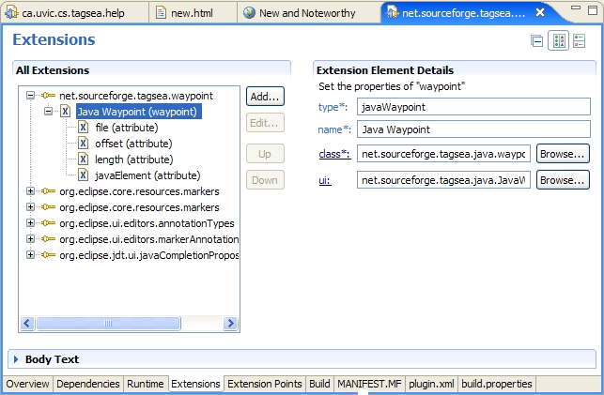
Extending TagSEA
Architecture and extension points

